Slide 1

Course code : CSE3009 Course title : No SQL Data Bases Module : 6 Topic : 3
Neo4j Query Execution

Slide 2
Objectives
This session will give the knowledge about
Neo4j Building Blocks
Cypher Query Language (CQL) Introduction

Slide 3
Neo4j - Building Blocks
Neo4j Graph Database has the following building blocks −
Nodes
Properties
Relationships
Labels
Data Browser

Slide 4
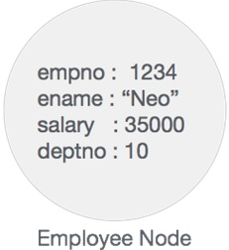
Node
Node is a fundamental unit of a Graph. It contains properties with key-value pairs as shown in the following image.
Here, Node Name = "Employee" and it contains a set of properties as key-value pairs.
Properties
Property is a key-value pair to describe Graph Nodes and Relationships.
Key = Value
Where Key is a String and Value may be represented using any Neo4j Data types.

Slide 5
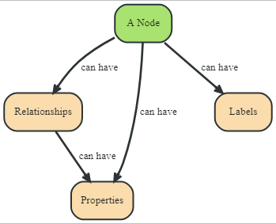
Node

Slide 6
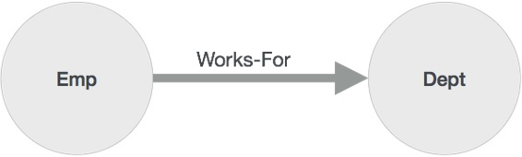
Relationships
Relationships are another major building block of a Graph Database. It connects two nodes as depicted in the following figure.
Here, Emp and Dept are two different nodes. "WORKS_FOR" is a relationship between Emp and Dept nodes. As it denotes, the arrow mark from Emp to Dept, this relationship describes −
Emp WORKS_FOR Dept
Each relationship contains one start node and one end node. Here, "Emp" is a start node, and "Dept" is an end node.

Slide 7
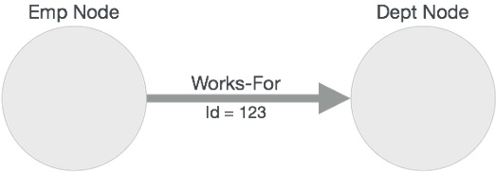
Relationships
As this relationship arrow mark represents a relationship from "Emp" node to "Dept" node, this relationship is known as an "Incoming Relationship" to "Dept" Node and "Outgoing Relationship" to "Emp" node.
Like nodes, relationships also can contain properties as key-value pairs.
Here, "WORKS_FOR" relationship has one property as key-value pair.
Id = 123
It represents an Id of this relationship.

Slide 8
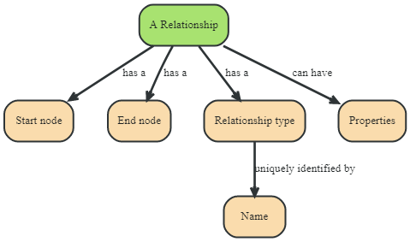

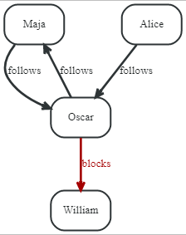


Relationships

Slide 9
Labels
Label associates a common name to a set of nodes or relationships. A node or relationship can contain one or more labels. We can create new labels to existing nodes or relationships. We can remove the existing labels from the existing nodes or relationships.
From the previous diagram, we can observe that there are two nodes.
Left side node has a Label: "Emp" and the right side node has a Label: "Dept".
Relationship between those two nodes also has a Label: "WORKS_FOR".
Note − Neo4j stores data in Properties of Nodes or Relationships.

Slide 10
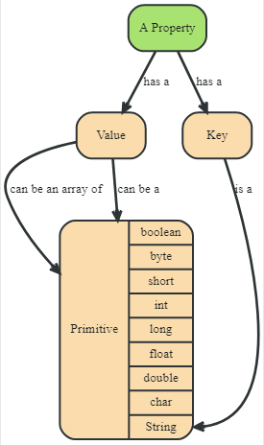
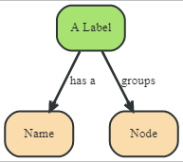
Properties Label

Slide 11
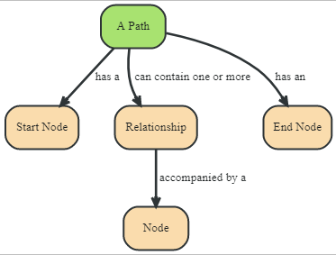
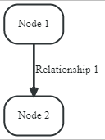

Paths

Slide 12
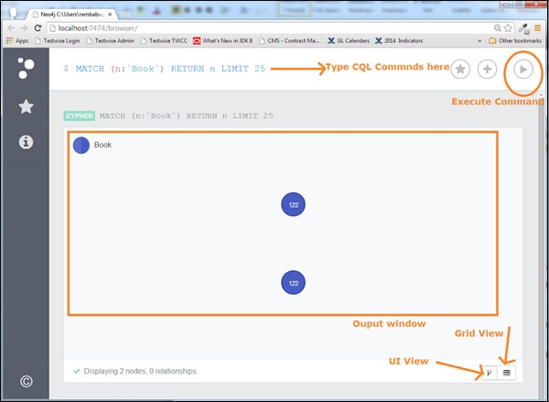
Neo4j Data Browser
Once we install Neo4j, we can access Neo4j Data Browser using the following URL:
http://localhost:7474/browser/

Slide 13
Neo4j Data Browser
Neo4j Data Browser is used to execute CQL commands and view the output.
Here, we need to execute all CQL commands at dollar prompt: "$"
Type commands after the dollar symbol and click the "Execute" button to run your commands.
It interacts with Neo4j Database Server, retrieves and displays the results just below the dollar prompt.
Use "VI View" button to view the results in diagrams format. The above diagram shows results in "UI View" format.
Use "Grid View" button to view the results in Grid View. The following diagram shows the same results in "Grid View" format.

Slide 14
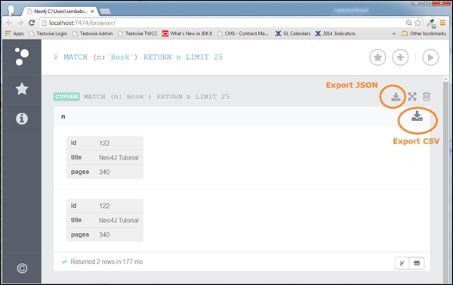
Neo4j Data Browser
When we use "Grid View" to view our Query results, we can export them into a file in two different formats.

Slide 15
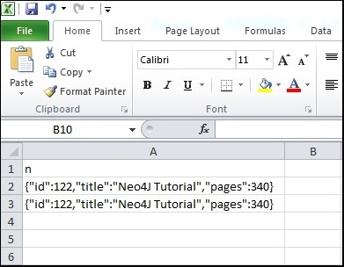
Neo4j export CSV
Click the "Export CSV" button to export the results in csv file format.

Slide 16
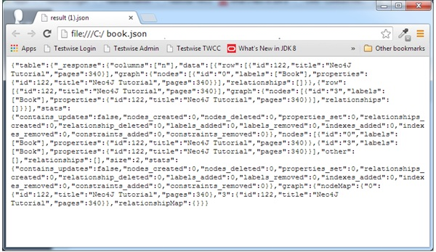
Neo4j export JSON
Click the "Export JSON" button to export the results in JSON file format.
However, if we use "UI View" to see our Query results, we can export them into a file in only one format: JSON

Slide 17
Neo4j - CQL
CQL stands for Cypher Query Language. Like Oracle Database has query language SQL, Neo4j has CQL as query language.
Neo4j CQL
Is a query language for Neo4j Graph Database.
Is a declarative pattern-matching language.
Follows SQL like syntax.
Syntax is very simple and in human readable format.

Slide 18
Oracle SQL VS CQL
Neo4j CQL has commands to perform Database operations.
Neo4j CQL supports many clauses such as WHERE, ORDER BY, etc., to write very complex queries in an easy manner.
Neo4j CQL supports some functions such as String, Aggregation. In addition to them, it also supports some Relationship Functions.

Slide 19
Neo4j CQL: Write Clauses
Following are the write clauses of Neo4j Cypher Query Language
Sr.No | Write Clause | Usage
1 | CREATE | This clause is used to create nodes, relationships, and properties.
2 | MERGE | This clause verifies whether the specified pattern exists in the graph. If not, it creates the pattern.
3 | SET | This clause is used to update labels on nodes, properties on nodes and relationships.
4 | DELETE | This clause is used to delete nodes and relationships or paths etc. from the graph.

Slide 20
Neo4j CQL : Write Clauses
Sr.No | Write Clause | Usage
5 | REMOVE | This clause is used to remove properties and elements from nodes and relationships.
6 | FOREACH | This class is used to update the data within a list.
7 | CREATE UNIQUE | Using the clauses CREATE and MATCH, you can get a unique pattern by matching the existing pattern and creating the missing one.
8 | Importing CSV files with Cypher | Using Load CSV you can import data from .csv files.

Slide 21
Neo4j CQL : Read Clauses
Following are the read clauses of Neo4j Cypher Query Language
Sr.No | Read Clauses | Usage
1 | MATCH | This clause is used to search the data with a specified pattern.
2 | OPTIONAL MATCH | This is the same as match, the only difference being it can use nulls in case of missing parts of the pattern.
3 | WHERE | This clause id is used to add contents to the CQL queries.
4 | START | This clause is used to find the starting points through the legacy indexes.
5 | LOAD CSV | This clause is used to import data from CSV files.

Slide 22
Neo4j CQL: General Clauses
Following are the general clauses of Neo4j Cypher Query Language
Sr.No | General Clauses | Usage
1 | RETURN | This clause is used to define what to include in the query result set.
2 | ORDER BY | This clause is used to arrange the output of a query in order. It is used along with the clauses RETURN or WITH.
3 | LIMIT | This clause is used to limit the rows in the result to a specific value.

Slide 23
Neo4j CQL: General Clauses
Sr.No | General Clauses | Usage
4 | SKIP | This clause is used to define from which row to start including the rows in the output.
5 | WITH | This clause is used to chain the query parts together.
6 | UNWIND | This clause is used to expand a list into a sequence of rows.
7 | UNION | This clause is used to combine the result of multiple queries.
8 | CALL | This clause is used to invoke a procedure deployed in the database.

Slide 24
Neo4j CQL Functions
Following are the frequently used Neo4j CQL Functions
Sr.No | CQL Functions | Usage
1 | String | They are used to work with String literals.
2 | Aggregation | They are used to perform some aggregation operations on CQL Query results.
3 | Relationship | They are used to get details of relationships such as startnode, endnode, etc.

Slide 25
Neo4j CQL Data Types
Sr.No | CQL Data Type | Usage
1 | Boolean | It is used to represent Boolean literals: true, false.
2 | byte | It is used to represent 8-bit integers.
3 | short | It is used to represent 16-bit integers.
4 | int | It is used to represent 32-bit integers.
5 | long | It is used to represent 64-bit integers.
6 | float | It is used to represent 32-bit floating-point numbers.
7 | double | It is used to represent 64-bit floating-point numbers.
8 | char | It is used to represent 16-bit characters.
9 | String | It is used to represent Strings.

Slide 26
Neo4j CQL Operators
Sr.No | Type | Operators
1 | Mathematical | +, -, *, /, %, ^
2 | Comparison | +, <>, <, >, <=, >=
3 | Boolean | AND, OR, XOR, NOT
4 | String | +
5 | List | +, IN, [X], [X…..Y]
6 | Regular Expression | =-
7 | String matching | STARTS WITH, ENDS WITH, CONSTRAINTS

Slide 27
Neo4j CQL Boolean Operators
Sr.No | Boolean Operators | Description
1 | AND | It is a Neo4j CQL keyword to support AND operation. It is like SQL AND operator.
2 | OR | It is a Neo4j CQL keyword to support OR operation. It is like SQL AND operator.
3 | NOT | It is a Neo4j CQL keyword to support NOT operation. It is like SQL AND operator.
4 | XOR | It is a Neo4j CQL keyword to support XOR operation. It is like SQL AND operator.

Slide 28
Neo4j CQL Comparison Operators
Sr.No | Boolean Operators | Description
1 | = | It is a Neo4j CQL "Equal To" operator.
2 | < > | It is a Neo4j CQL "Not Equal To" operator.
3 | < | It is a Neo4j CQL "Less Than" operator.
4 | > | It is a Neo4j CQL "Greater Than" operator.
5 | <= | It is a Neo4j CQL "Less Than Or Equal To" operator.
6 | > = | It is a Neo4j CQL "Greater Than Or Equal To" operator.

Slide 29
Summary
This session will give the knowledge about
Neo4j Building Blocks
Cypher Query Language (CQL) Introduction

